Slide 1
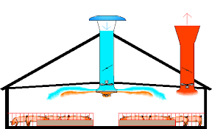

Long wave
exchange
Forced
ventilation
Solar
heating
Conduction
Ground
heat flux

Slide 2
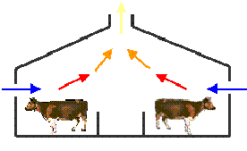
Long wave
exchange
Bouyancy
ventilation
Solar
heating
Free
ventilation
Conduction
Ground
heat flux

Slide 3
Set aperture
to maximum
Is TmaxV greater than Tmax?
Set aperture
to minimum
Is TminV less than
Tmin?
Calculate Vmin and Vmax
Calculate αlow and αhigh
Calculate Vopt
Is Vopt <=Vmin?
Set aperture
to αlow
Ti=Tmax
Is Vopt >=Vmax?
Set maximum
aperture
Set aperture
to αhigh
Ti=Tmin
Set minimum
aperture
Set aperture to αopt
Ti=Topt

